Slide 1
Hardware & Software for Scaled Vehicle Courses
AuE-8360 Scaled Autonomous Vehicles
Chinmay Samak
PhD Candidate, CU-ICAR
csamak@clemson.edu
Tanmay Samak
PhD Candidate, CU-ICAR
tsamak@clemson.edu

Slide 2
Hardware
Hardware Platforms for Scaled Vehicle Courses

Slide 3
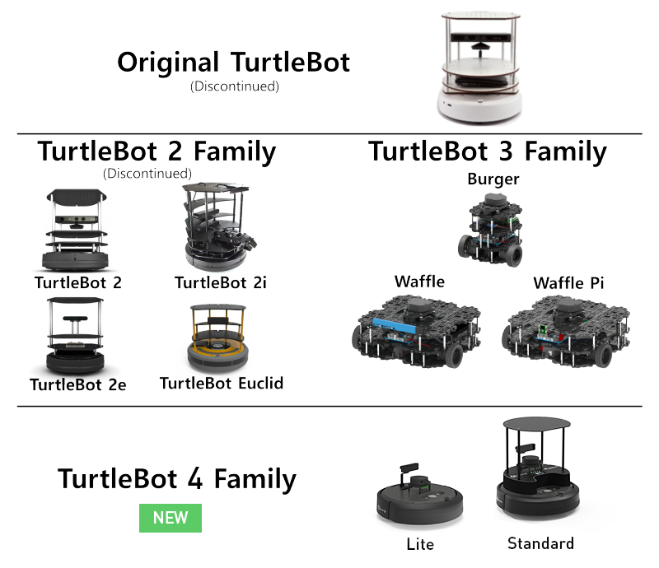
Robot-Like Platforms
ROS enabled (TB1-3)
ROS2 enabled (TB3-4)
TurtleBot
Differential drive (TB1-4)
Multi-sensor lineups (TB3-4)
Multi-mode actuators (TB3)
Small form factor (TB3)
Affordable cost (TB3)
Open hardware (TB3)
Open firmware (TB3)
Open software (TB1-4)
Version | Mobile Base | Battery | Computer(s) | Sensor(s) | Actuator(s) | Developer | Release | Cost
TurtleBot1 | iRobot Create | 3000 mAh | Asus 1215N Laptop | Gyro, MS Kinect (RGBD-Cam), Encoders | iRobot Create Robot Base Motors | Willow Garage | Nov 2010 | $1,400
TurtleBot2 | Yujin Kobuki | 2200 mAh | Asus 1215N Laptop | Gyro, MS Kinect (RGBD-Cam), Encoders | iClebo Kobuki Robot Base Motors | Yujin Robot | Oct 2012 | $1,500
TurtleBot3 | Burger, Waffle, Waffle Pi | 1800 mAh | Raspberry Pi (or Intel Joule 570x), OpenCR1.0 | 2D LiDAR, 9-Axis IMU, Encoders, Pi Camera (Mono-Cam), Intel RealSense RGBD-Cam | DYNAMIXEL Servo Motors | ROBOTIS, OSRF | May 2017 | $650
TurtleBot4 | iRobot Create3 | 1800 mAh | Raspberry Pi 4B | 2D LiDAR, Stereo-Depth Camera, 6-Axis IMU, Encoders, Bumper Zones, IR Cliff and Obstacle Sensors, Optical Flow Sensor | iRobot Create3 Drive Actuators | Clearpath | July 2022 | $1,900
Source: TurtleBot.com

Slide 4
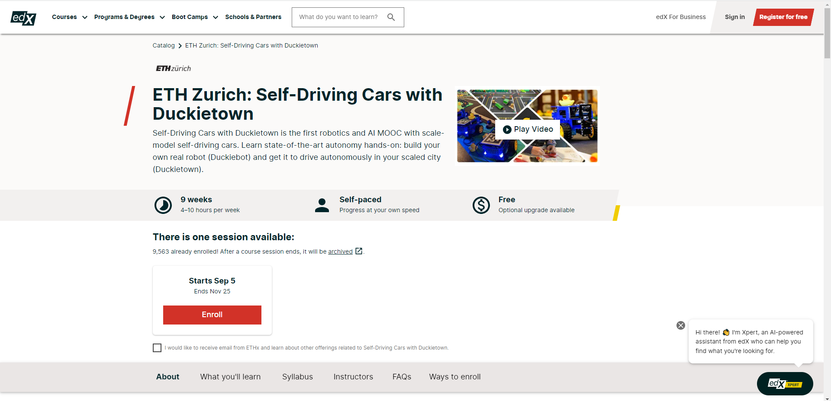
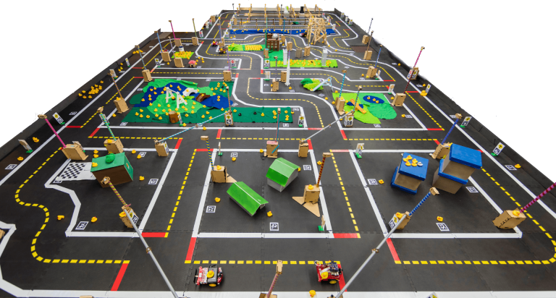
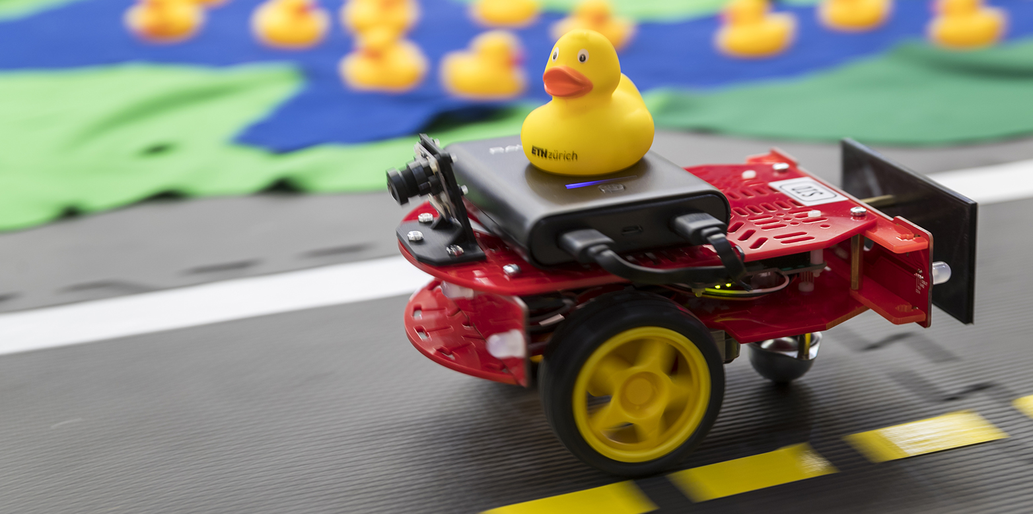
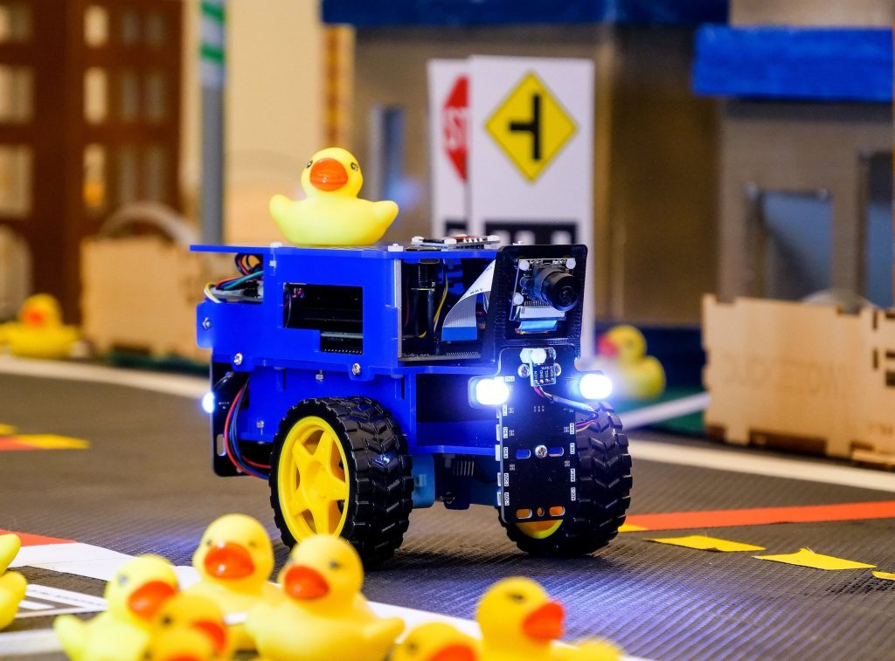
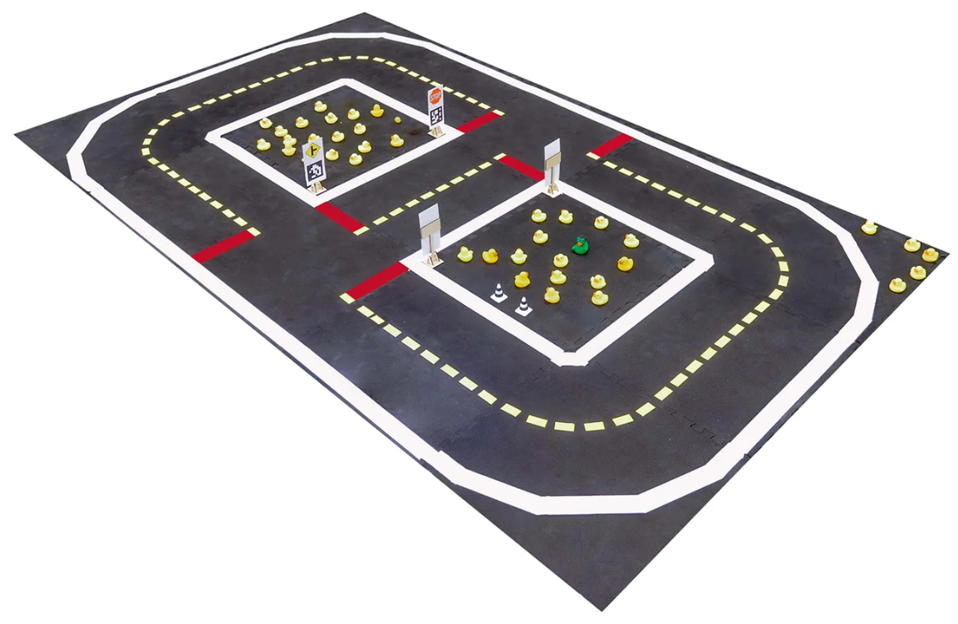
Robot-Like Platforms
Duckietown
Differential drive
Scaled robot
Scaled infrastructure
Small form factor
Affordable cost
Open hardware
Open firmware
Open software
Source: edX.org
Version | Mobile Base | Battery | Computer(s) | Sensor(s) | Actuator(s) | Developer | Release | Cost
Duckiebot | Open-Source | 1000 mAh | Raspberry Pi (or Jetson Nano) | Pi Camera (Mono-Cam), IMU*, Encoders* | DC Motors | Duckietown | 2016 | $450
+
=
Source: Duckietown.org

Slide 5
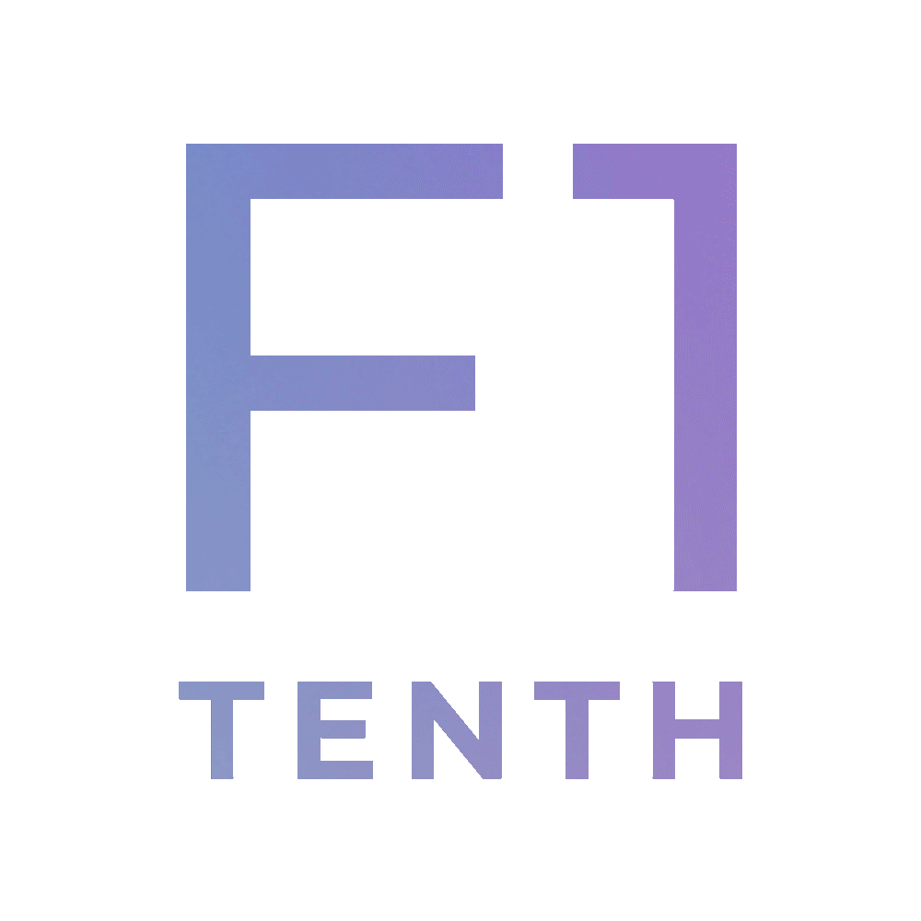
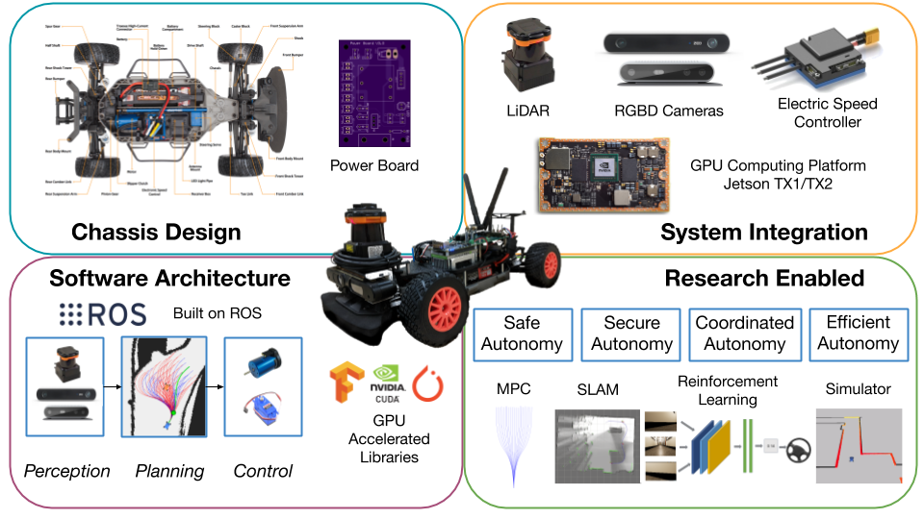
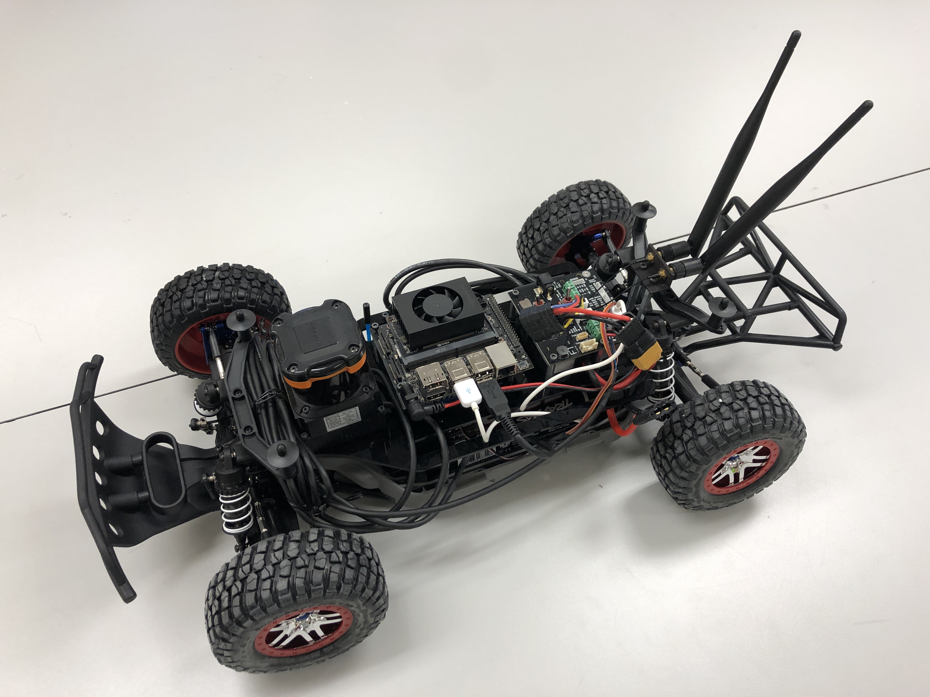
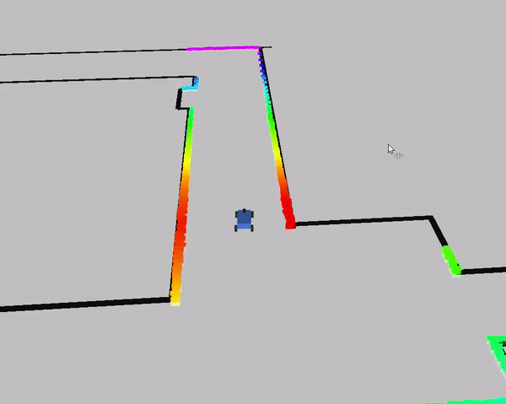
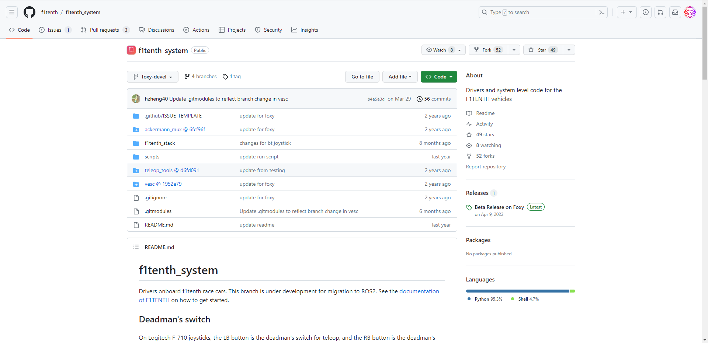
Car-Like Platforms
ROS enabled
ROS2 enabled
Autoware enabled
F1TENTH
Ackermann steered
1/10 scale RC-car
Open source
Moderate form factor
Learning resources
Build documentation
Racing competitions
University distribution
Version | Mobile Base | Battery | Computer(s) | Sensor(s) | Actuator(s) | Developer | Release | Cost
F1TENTH | Traxxas Slash | 4000 mAh | Jetson Xavier NX | Hokuyo 10LX LIDAR | BLDC Motor, Steering Servo | UPenn | 2016 | $3,260
+
+
=
Source: F1TENTH.org

Slide 6
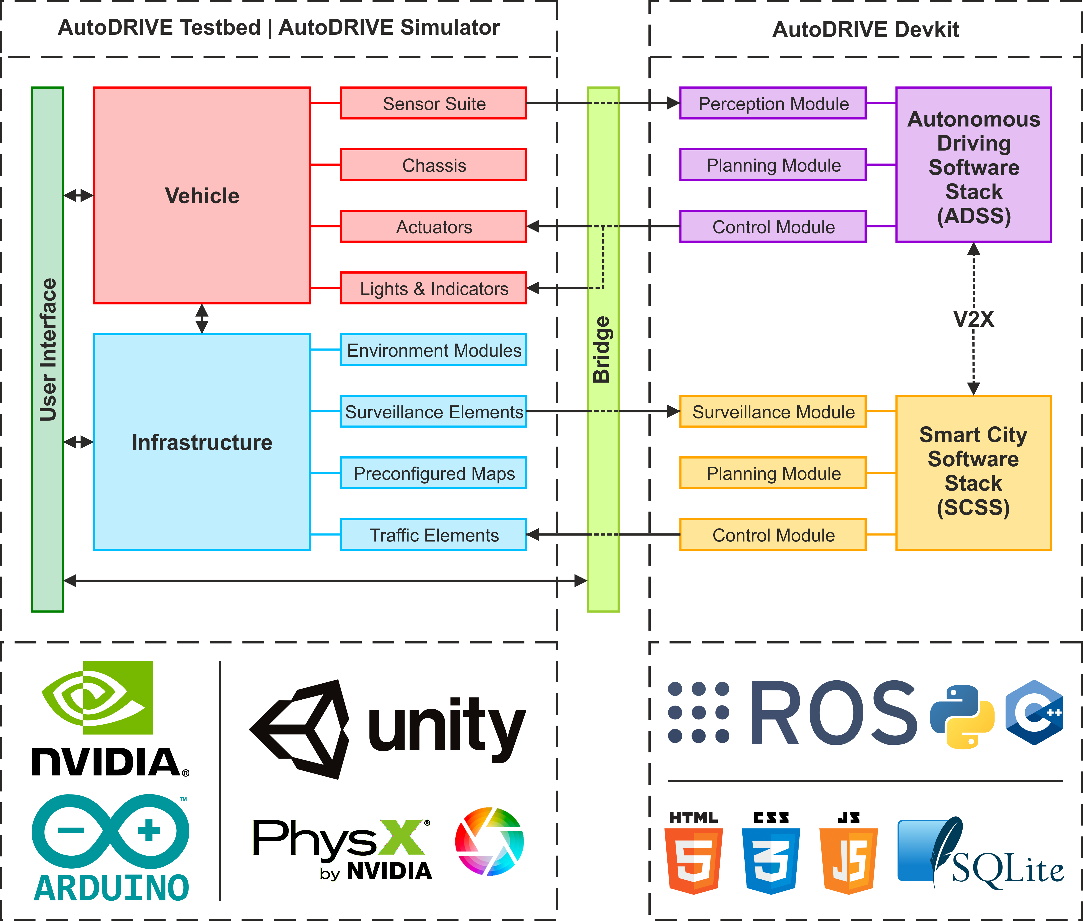
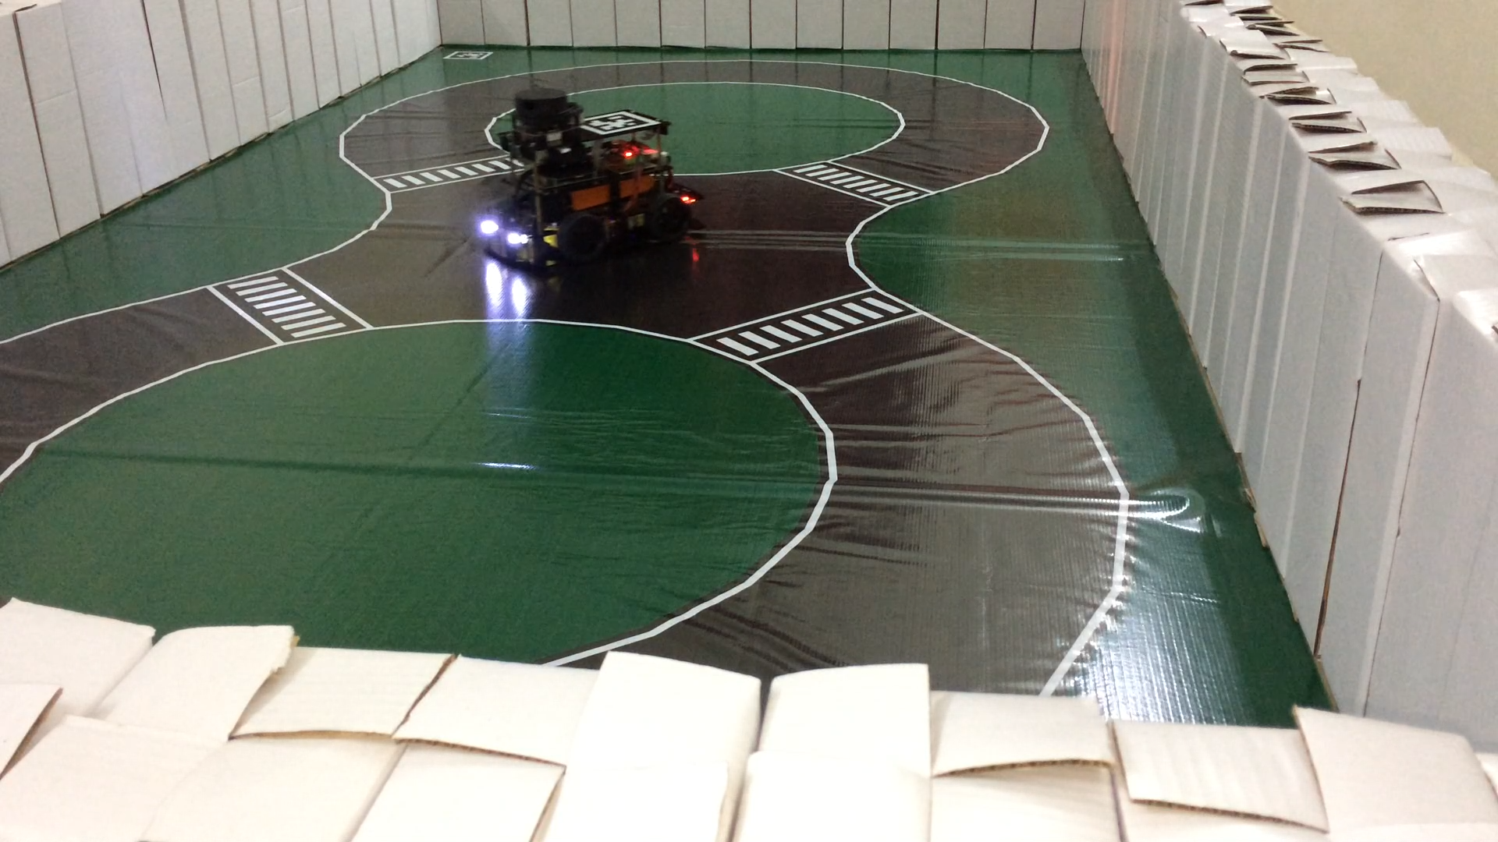
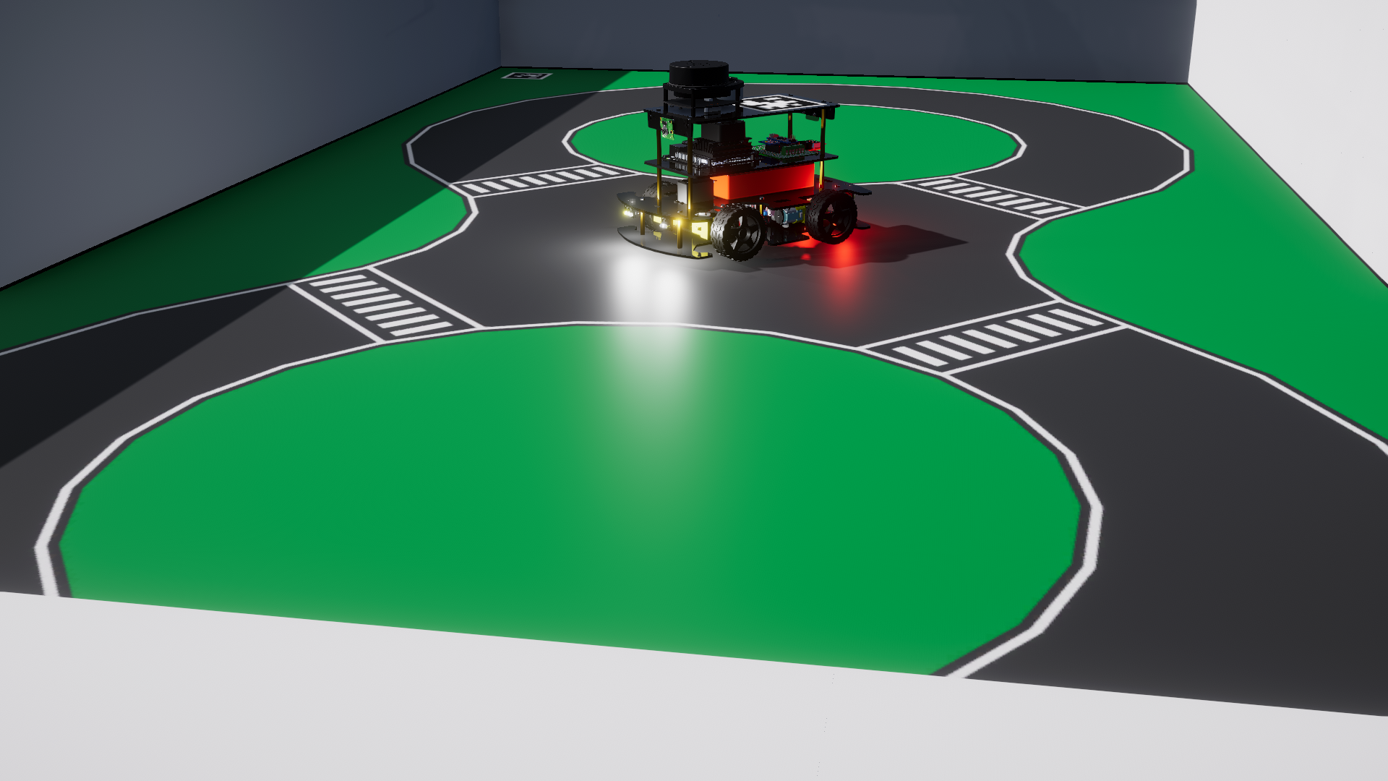
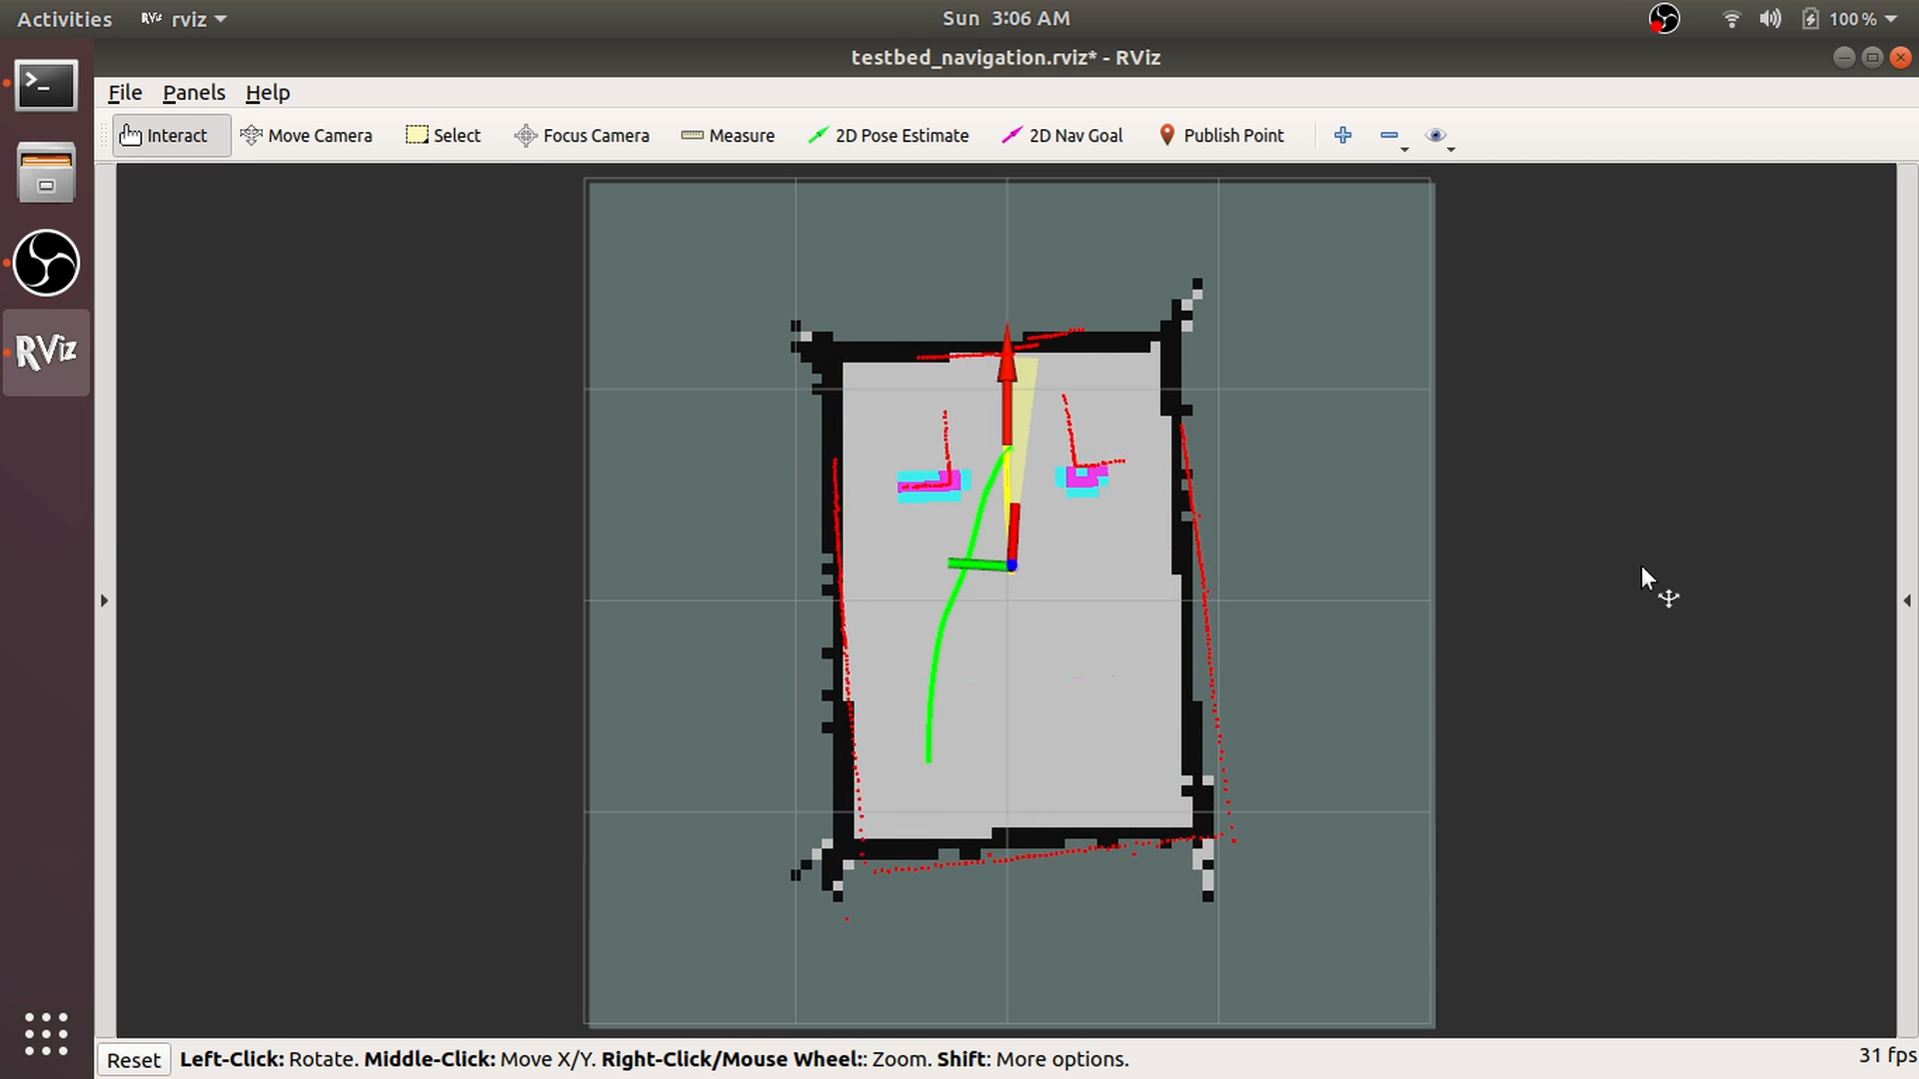
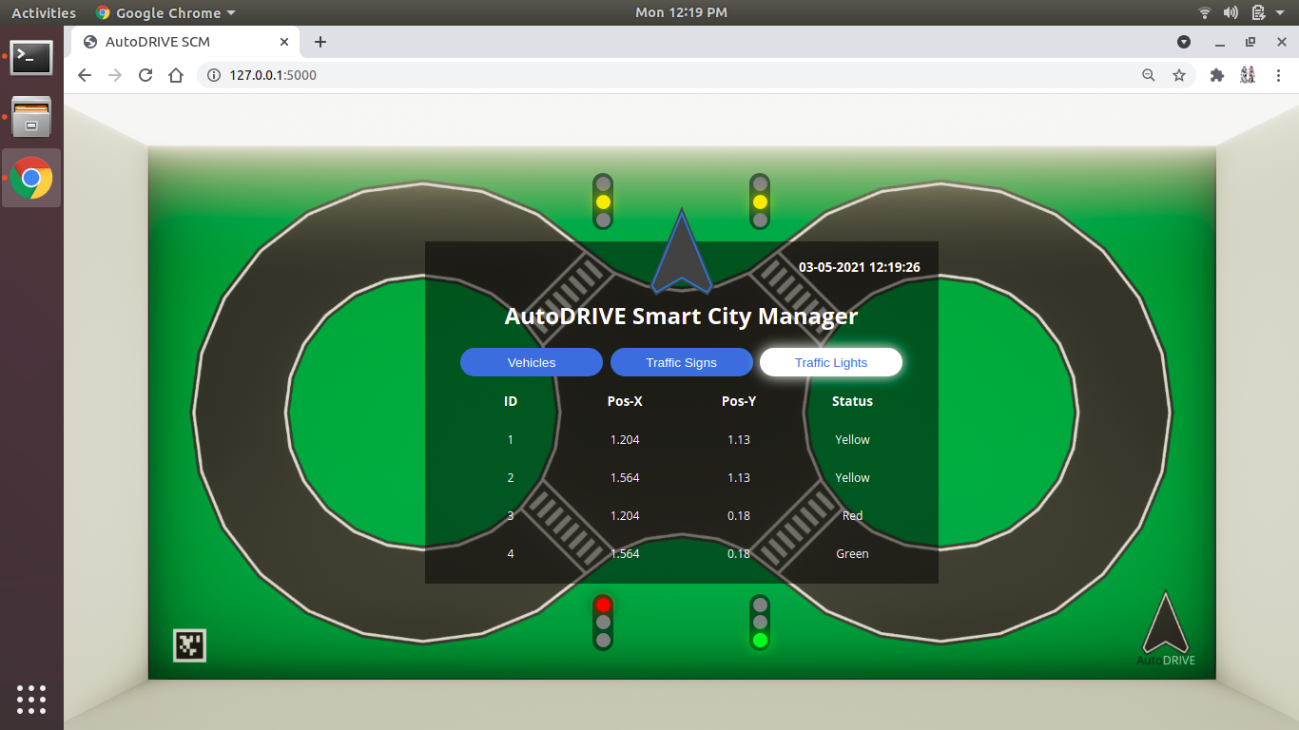
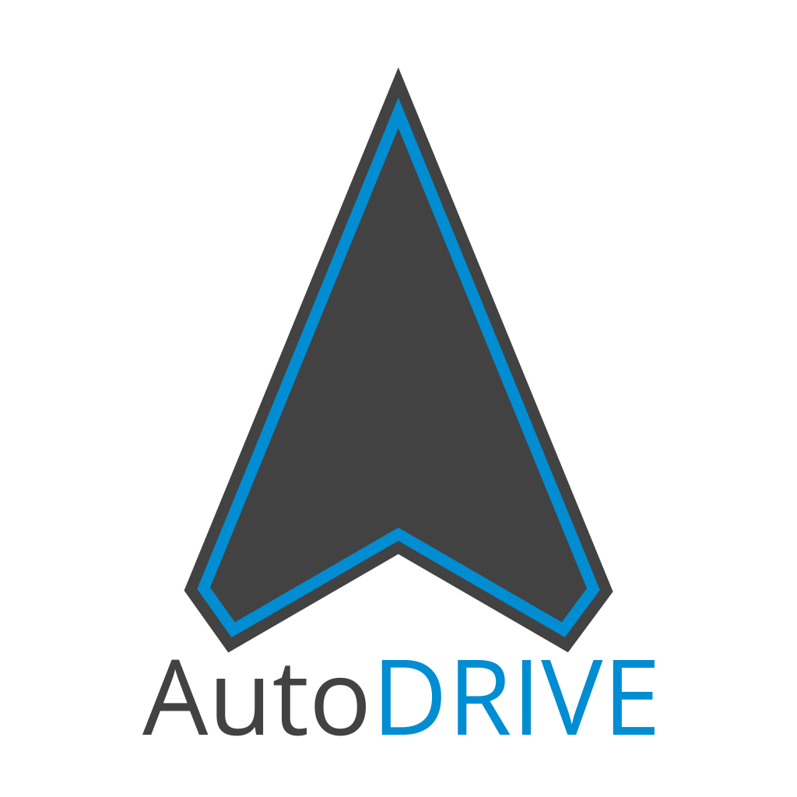
Car-Like Platforms
Website
GitHub
YouTube
AutoDRIVE Ecosystem
Ackermann-steer, skid-steer, independent 4WD4WS
1/14 scale open chassis
Scaled infrastructure
Small form factor
Flexible APIs
High-fidelity simulation
Mechatronic testbed
AD + SC applications
Affordable cost
Version | Mobile Base | Battery | Computer(s) | Sensor(s) | Actuator(s) | Developer | Release | Cost
Nigel | Open-Source | 5200 mAh | Jetson Nano or Jetson Orin Nano | RPLIDAR A-1, Pi-Cameras, Intel RealSense D435i, 9-Axis IMU, 6-Axis IPS, Encoders, Microphone, Steering Feedback, Throttle Feedback | DC Motors, Steering Servo(s) | CU-ICAR + NTU + SRMIST | 2021 | $450
=
Source: https://autodrive-ecosystem.github.io

Slide 7
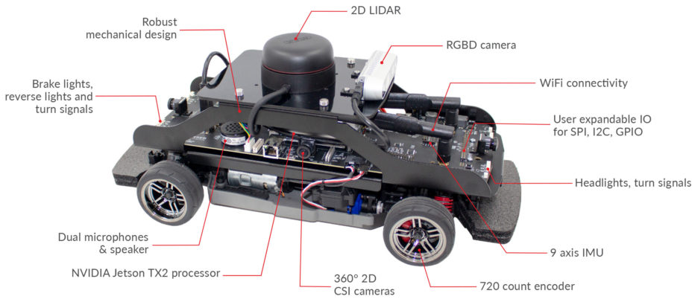
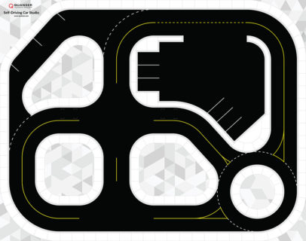
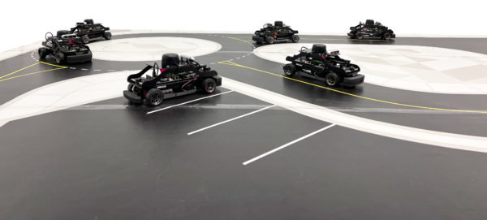
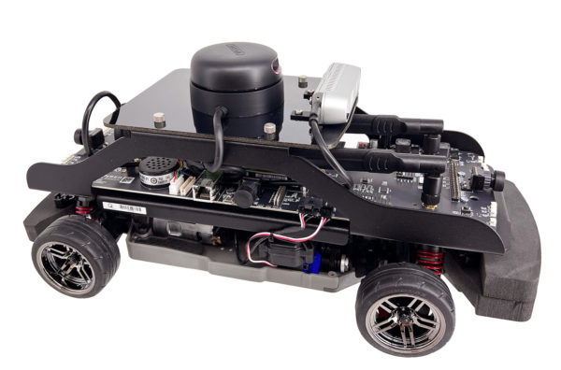
Car-Like Platforms
QCar
Ackermann steered
1/10 scale RC-car
Commercial
Small form factor
Resources
Sensor-rich
Powerful compute
QUARC-Simulink API
Source: Quanser.com
Version | Mobile Base | Battery | Computer(s) | Sensor(s) | Actuator(s) | Developer | Release | Cost
QCar | Traxxas RC Car | 3300 mAh | Jetson TX2 | Encoders, 9-Axis IMU, Mono-Cams, RGBD-Camera, 2D LIDAR | BLDC Motor, Steering Servo | Quanser | 2016 | $20,000
+
+
=
Source: Quanser.com

Slide 8
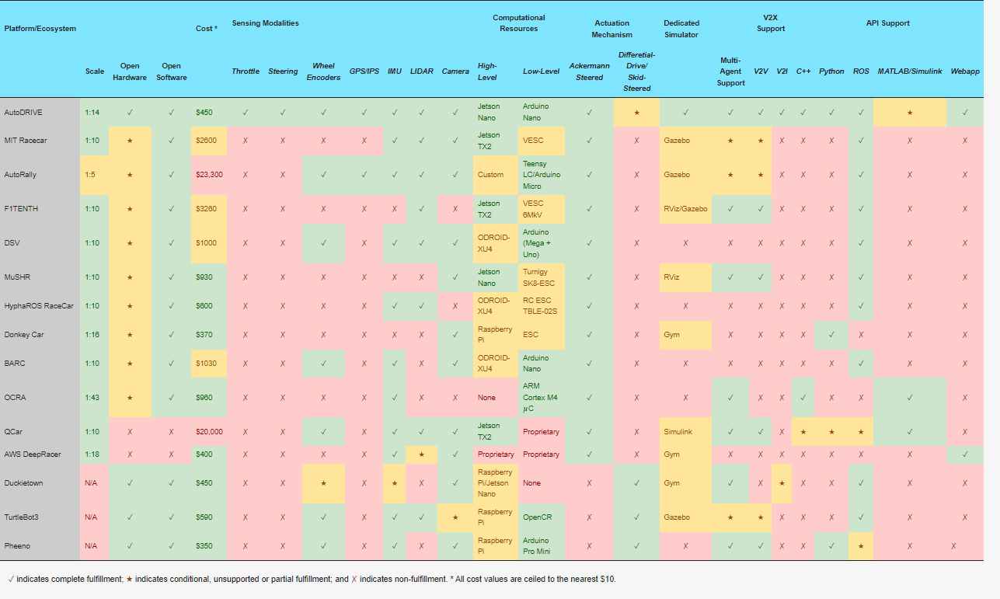
Hardware Platforms – Comparative Analysis
T. Samak, C. Samak, S. Kandhasamy, V. Krovi, and M. Xie, “AutoDRIVE: A Comprehensive, Flexible and Integrated Digital Twin Ecosystem for Autonomous Driving Research & Education,” Robotics, vol. 12, no. 3, p. 77, May 2023, doi: https://doi.org/10.3390/robotics12030077

Slide 9
Software
Software Frameworks for Scaled Vehicle Courses

Slide 10

Robot Operating System (ROS)
Robot Operating System (ROS) is a meta-OS
Plumbing: communication middleware (e.g. nodes, topics, messages, services, etc.)
Tools: monitor, visualize and debug (e.g. rqt, rviz, etc.)
Capabilities: out-of-the-box support for robot mobility and manipulation (e.g. perception, planning, control)
Community: developers and contributors across the globe (e.g. Open Robotics, Autoware, F1Tenth, etc.)
Source: ROS.org

Slide 11
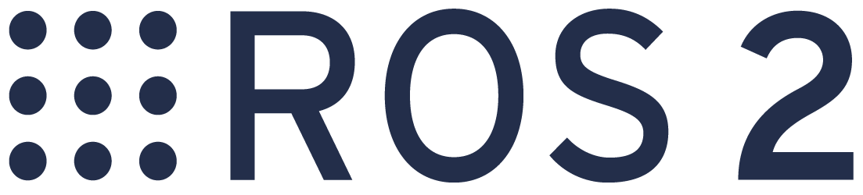
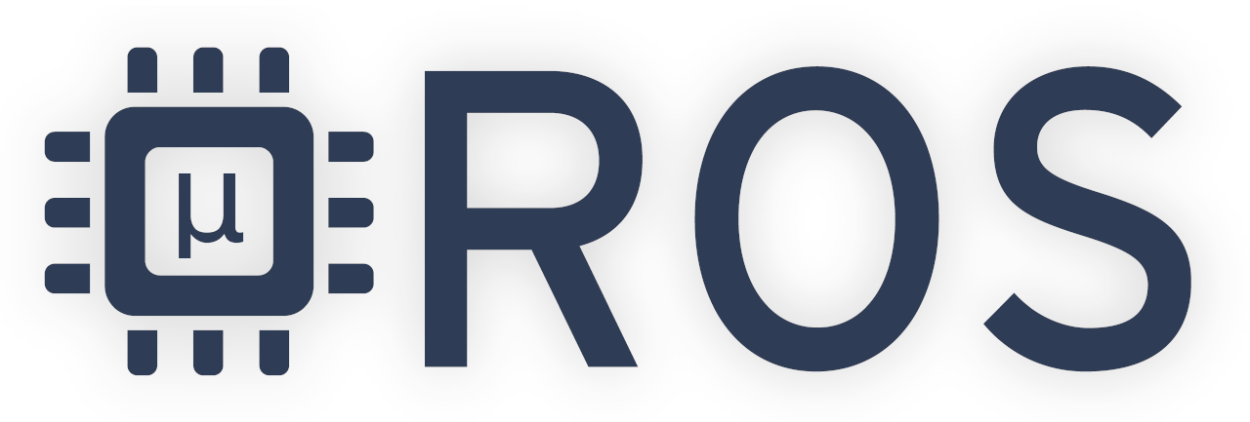
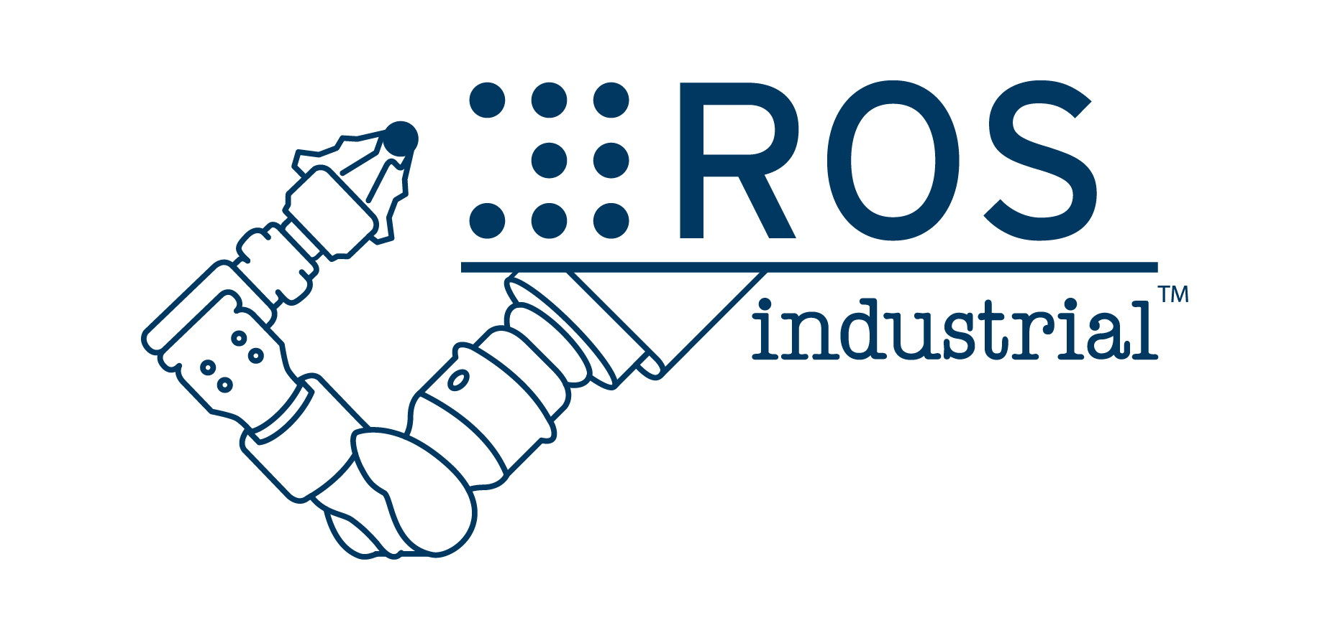

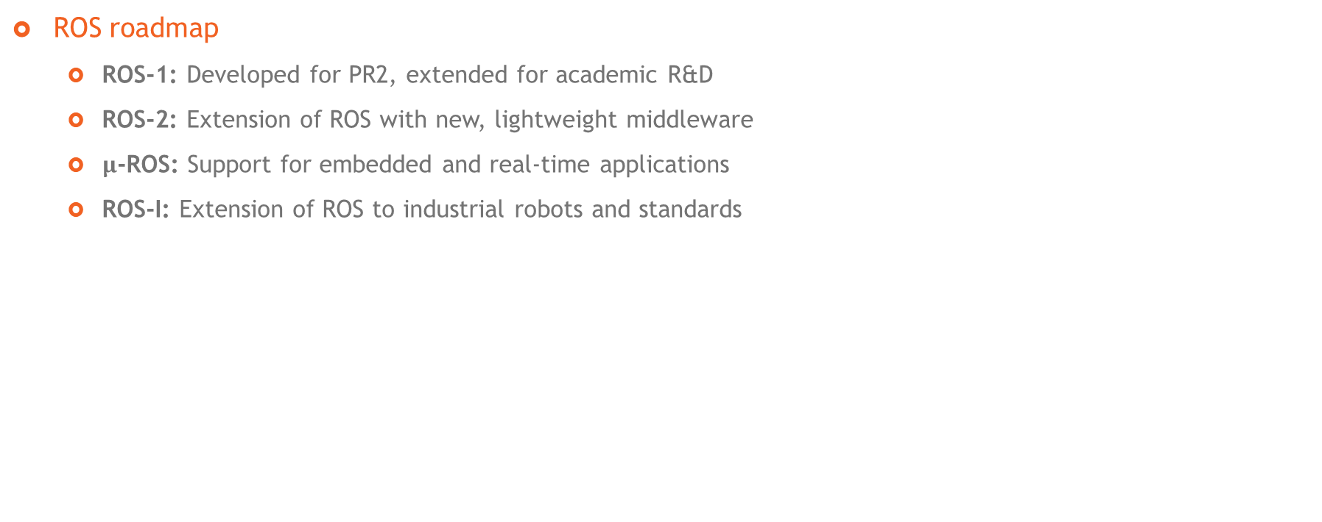
ROS – Overview
ROS roadmap
ROS-1: Developed for PR2, extended for academic R&D
ROS-2: Extension of ROS with new, lightweight middleware
$μ$-ROS: Support for embedded and real-time applications
ROS-I: Extension of ROS to industrial robots and standards

Slide 12
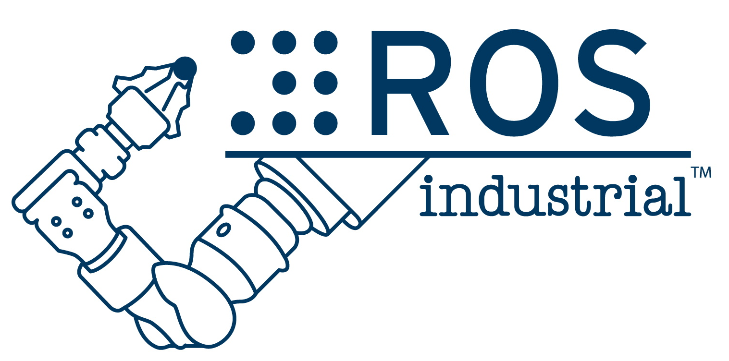
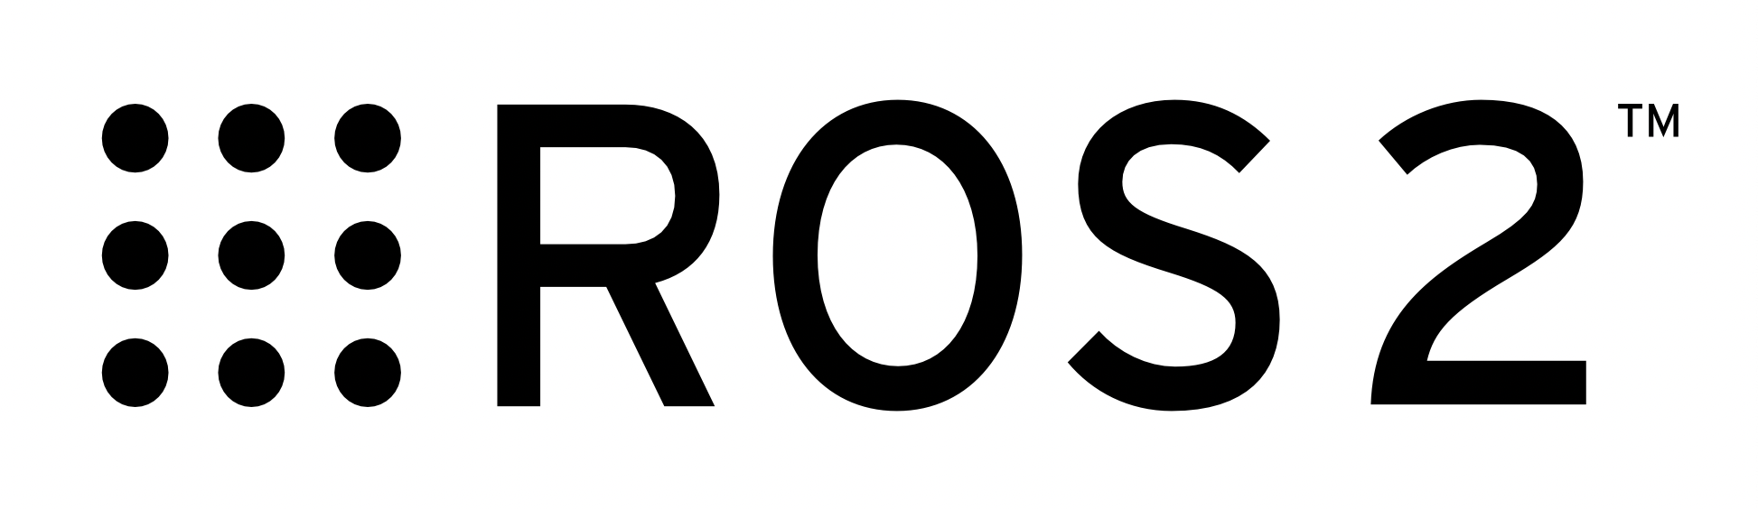
ROS – Resources
Documentation
https://wiki.ros.org/
Questions & answers
https://answers.ros.org/questions/
Support
http://wiki.ros.org/Support
Discussion forum
https://discourse.ros.org/
Documentation
http://wiki.ros.org/Industrial
Installation guide
http://wiki.ros.org/Industrial/Install
Tutorials
http://wiki.ros.org/Industrial/Tutorials
Discussion forum
https://discourse.ros.org/c/ros-industrial
Bug/feature tracking
https://github.com/ros-industrial/ros_industrial_issues
Documentation
https://docs.ros.org/en/foxy/index.html
Installation guide
https://docs.ros.org/en/foxy/Installation.html
Tutorials
https://docs.ros.org/en/foxy/Tutorials.html
https://docs.ros.org/en/foxy/How-To-Guides.html
Concepts
https://docs.ros.org/en/foxy/Concepts.html
Support
https://docs.ros.org/en/foxy/Contact.html

Slide 13
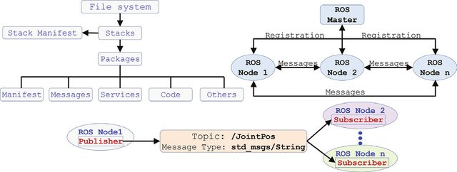
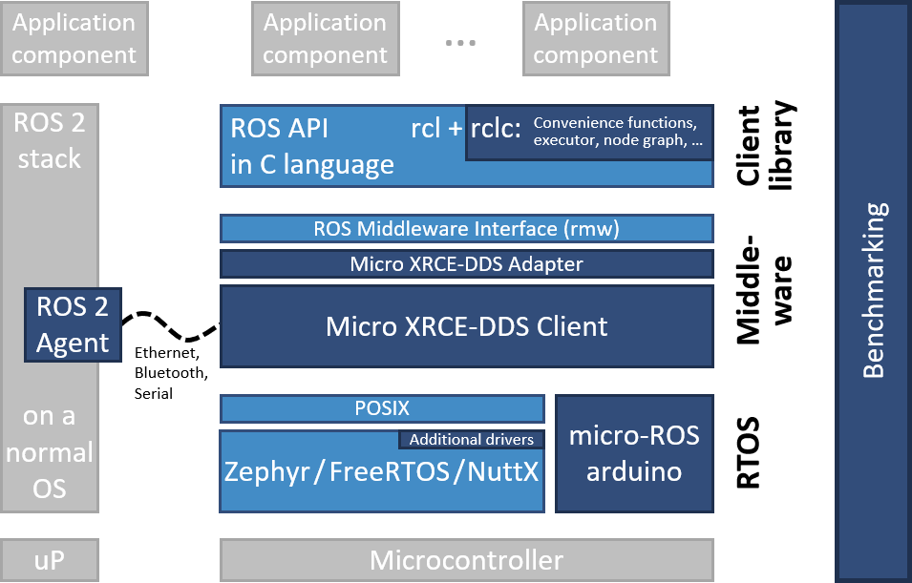
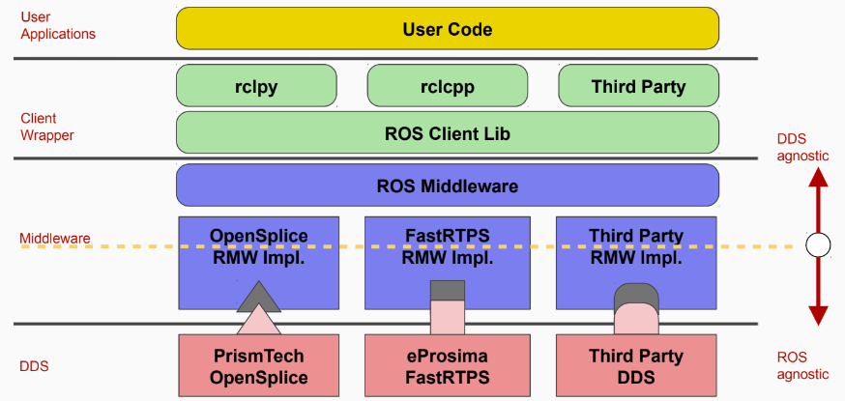
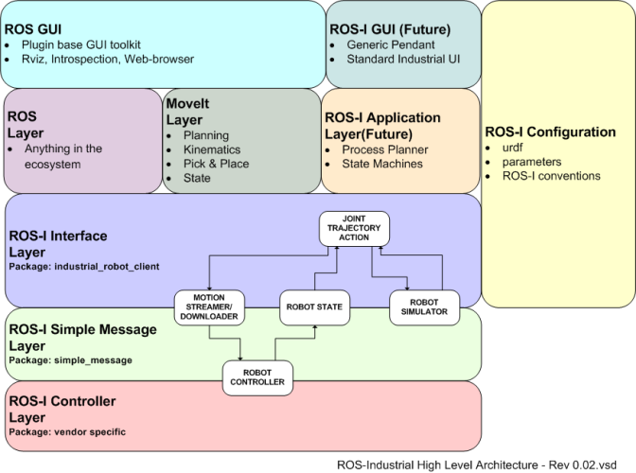

ROS – Deployment Architecture
ROS-1
$μ$-ROS
Source: ROS.org
Source: [3]
ROS-2
ROS-I
Source: ROS.org
Source: ROS.org

Slide 14
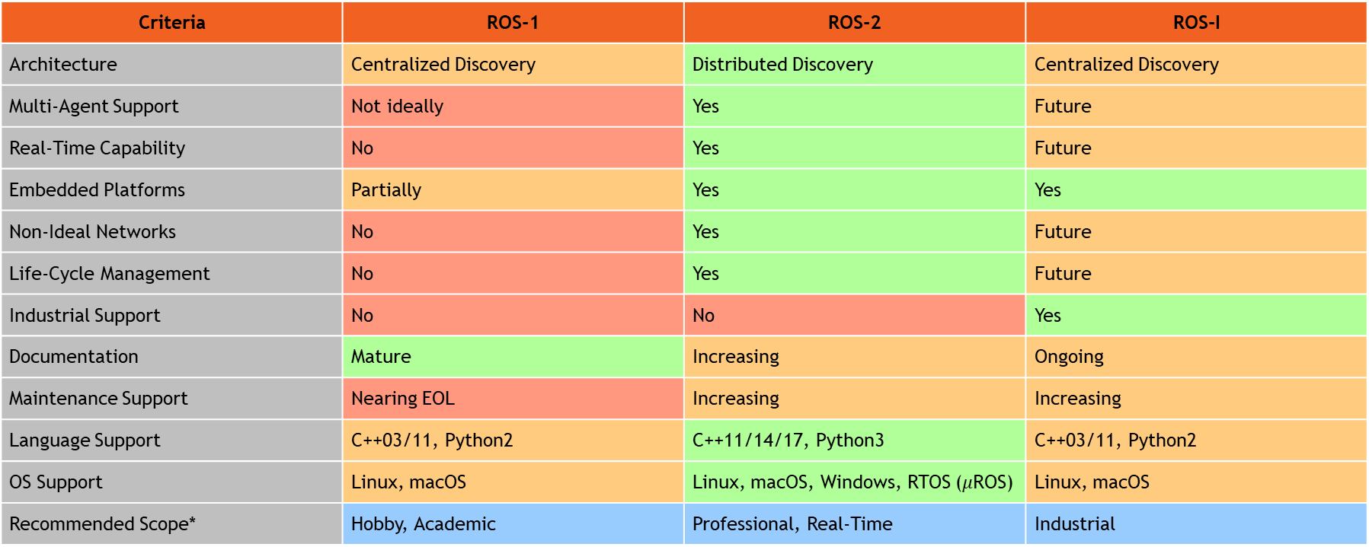
ROS – Comparative Analysis
Criteria | ROS-1 | ROS-2 | ROS-I
Architecture | Centralized Discovery | Distributed Discovery | Centralized Discovery
Multi-Agent Support | Not ideally | Yes | Future
Real-Time Capability | No | Yes | Future
Embedded Platforms | Partially | Yes | Yes
Non-Ideal Networks | No | Yes | Future
Life-Cycle Management | No | Yes | Future
Industrial Support | No | No | Yes
Documentation | Mature | Increasing | Ongoing
Maintenance Support | Nearing EOL | Increasing | Increasing
Language Support | C++03/11, Python2 | C++11/14/17, Python3 | C++03/11, Python2
OS Support | Linux, macOS | Linux, macOS, Windows, RTOS ($μ$ROS) | Linux, macOS
Recommended Scope* | Hobby, Academic | Professional, Real-Time | Industrial
*Recommendation is based on critical analysis presented in rows 1-11

Slide 15
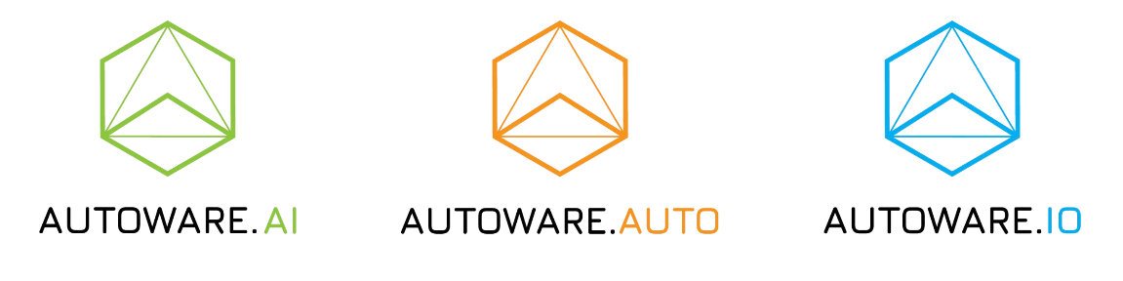
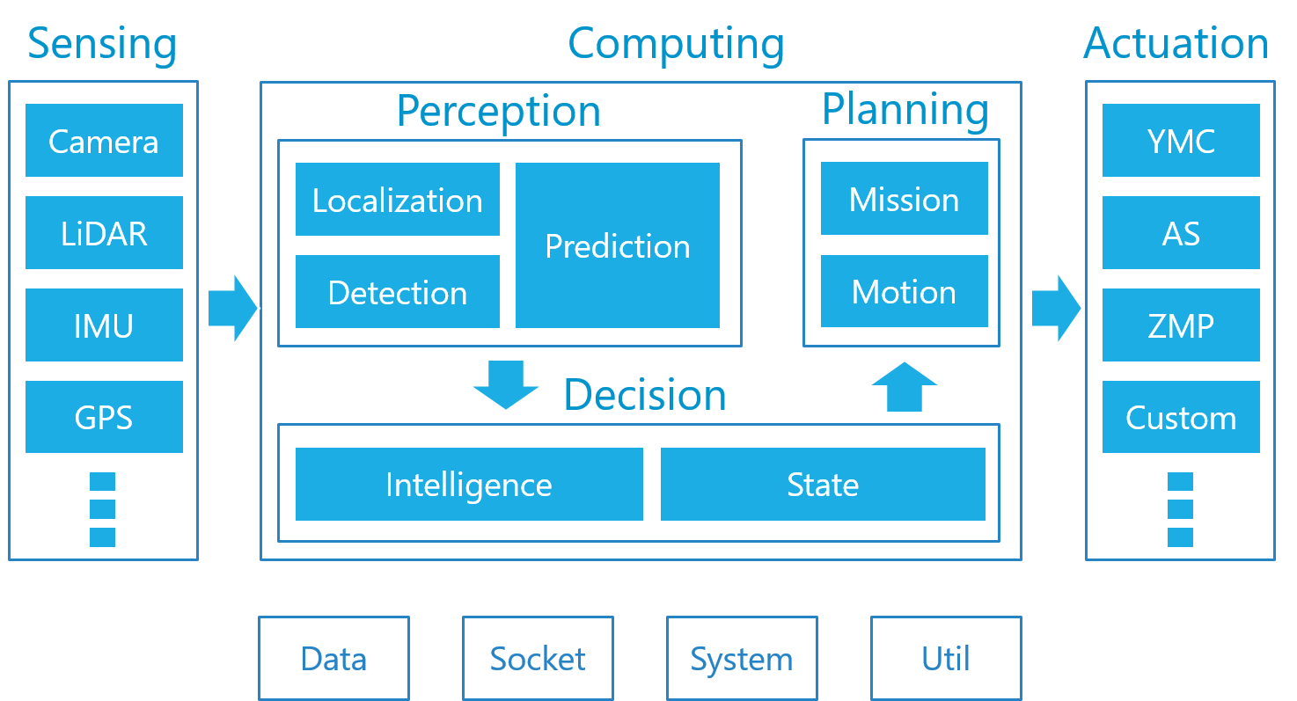
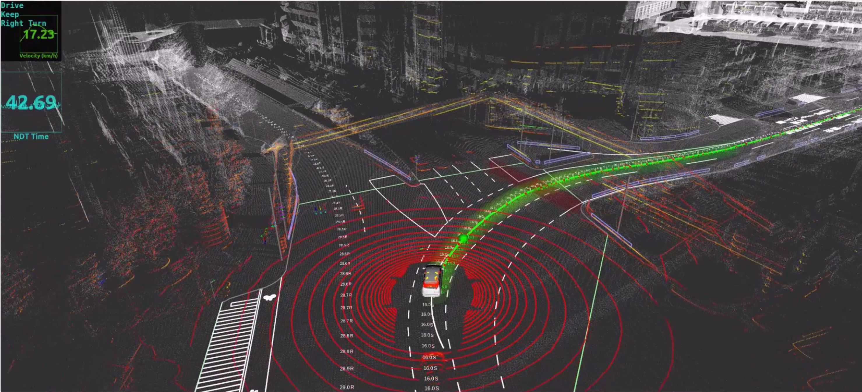
Autoware Stack
Autoware.AI
Started in 2015 by Shinpei Kato (Nagoya University)
Autonomous driving software stack (ROS-1)
Open source
Source: Autoware.org

Slide 16
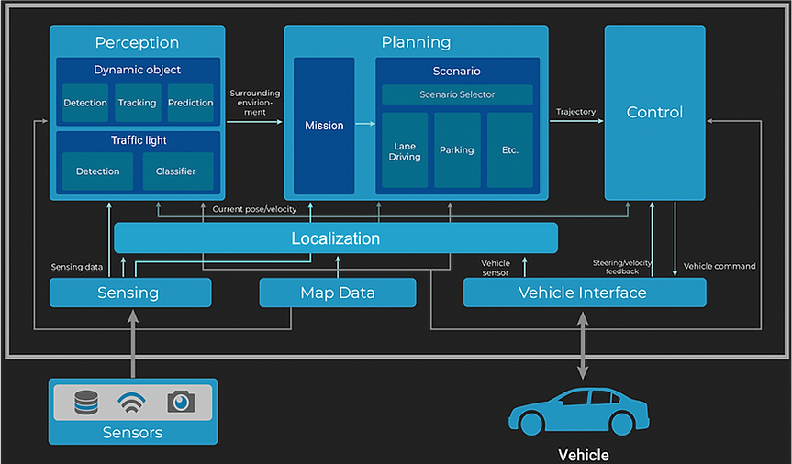
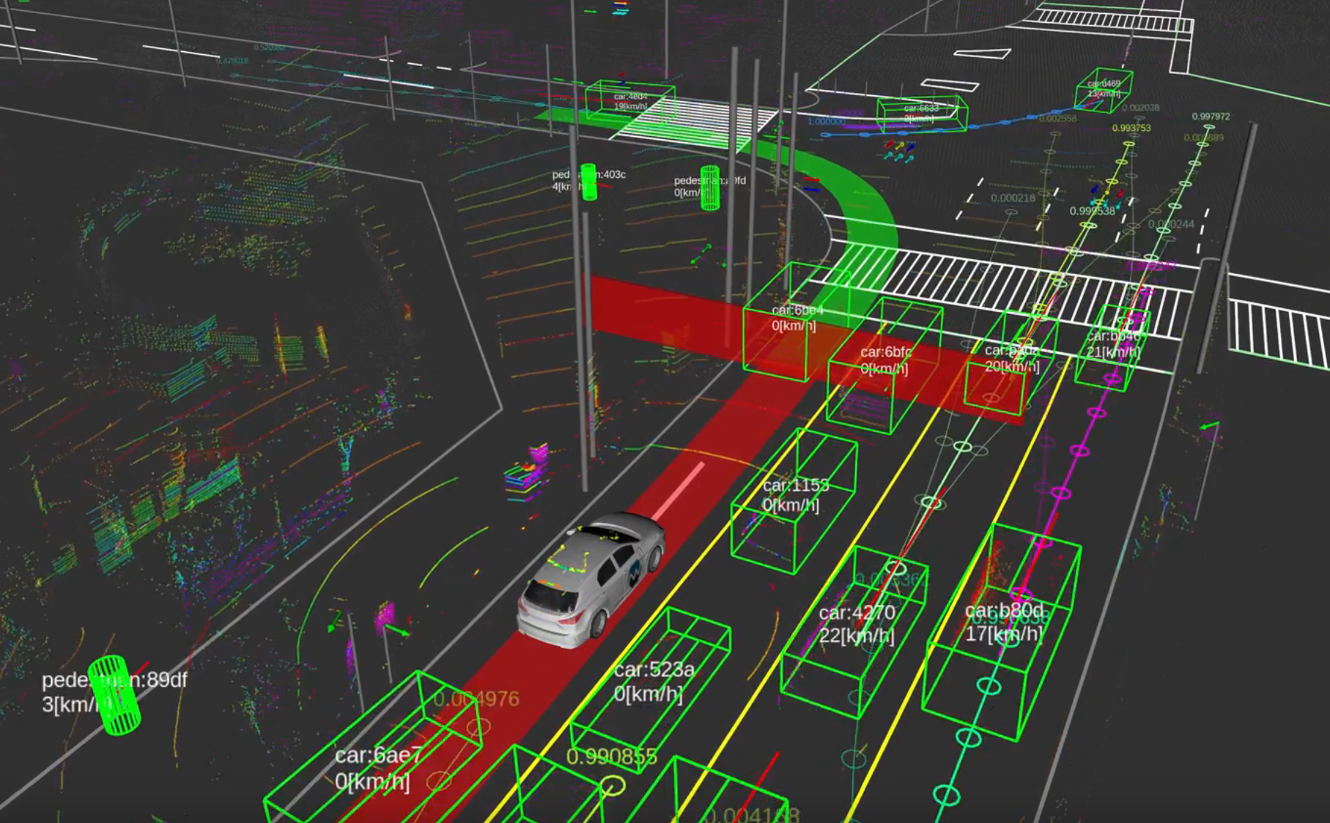
Autoware Stack
Autoware.Auto
Autonomous driving software stack (ROS-2)
Open source
Source: Autoware.org

Slide 17
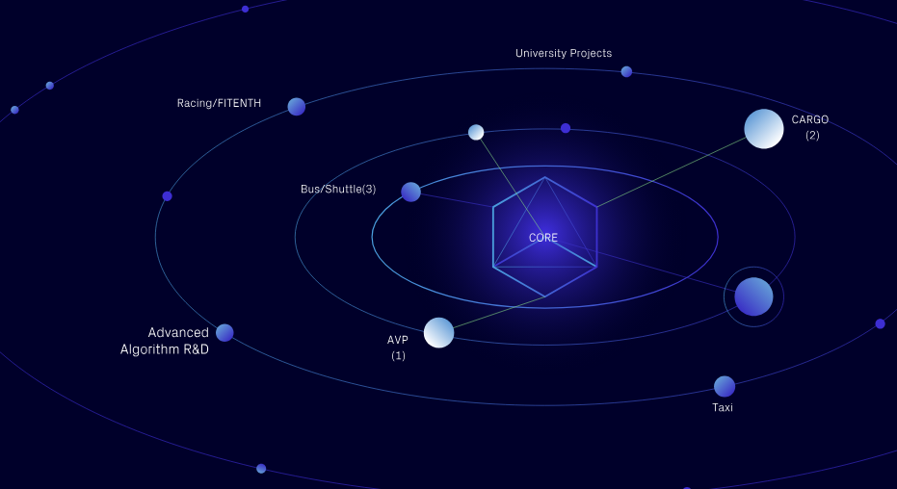
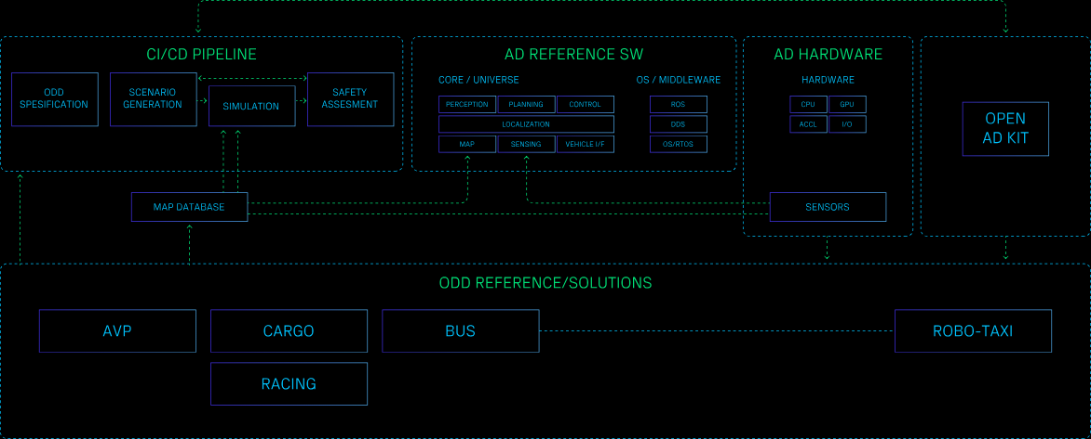
Autoware Stack
Autoware Core/Universe
Autoware Core: High-quality, stable ROS packages for AVs
Autoware Universe: Experimental, cutting-edge ROS packages
Autoware I/O
OpenAD Kit
ODD Reference/Solutions
Autonomous Valet Parking
Cargo Delivery
Racing
Robo-Bus/Shuttle
Robo-Taxi
Source: Autoware.org

Slide 18

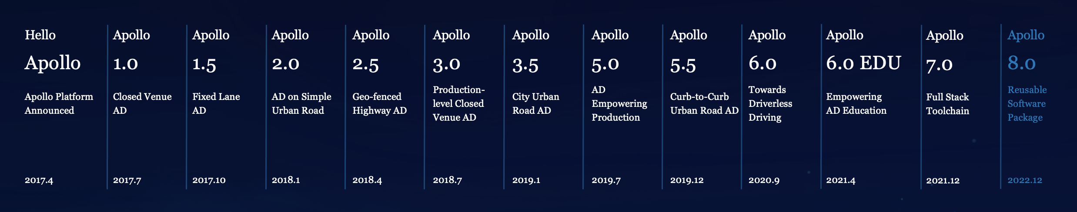
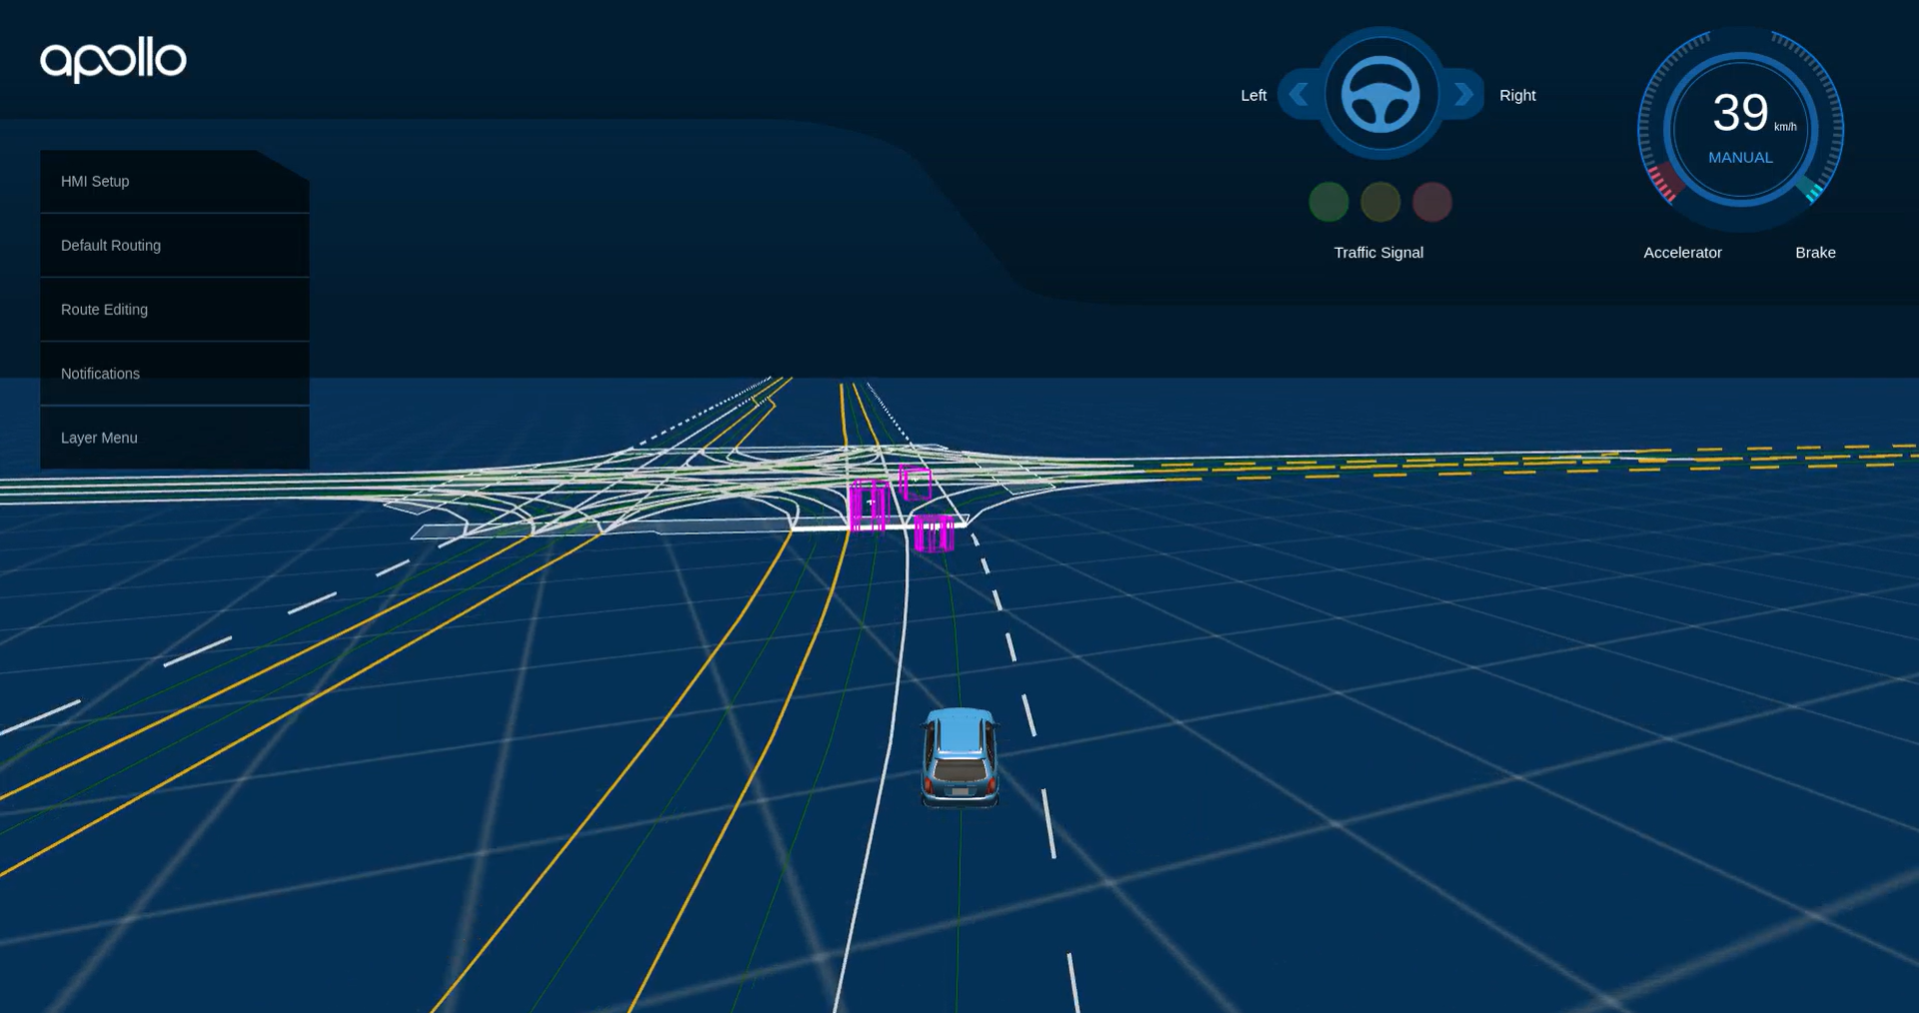
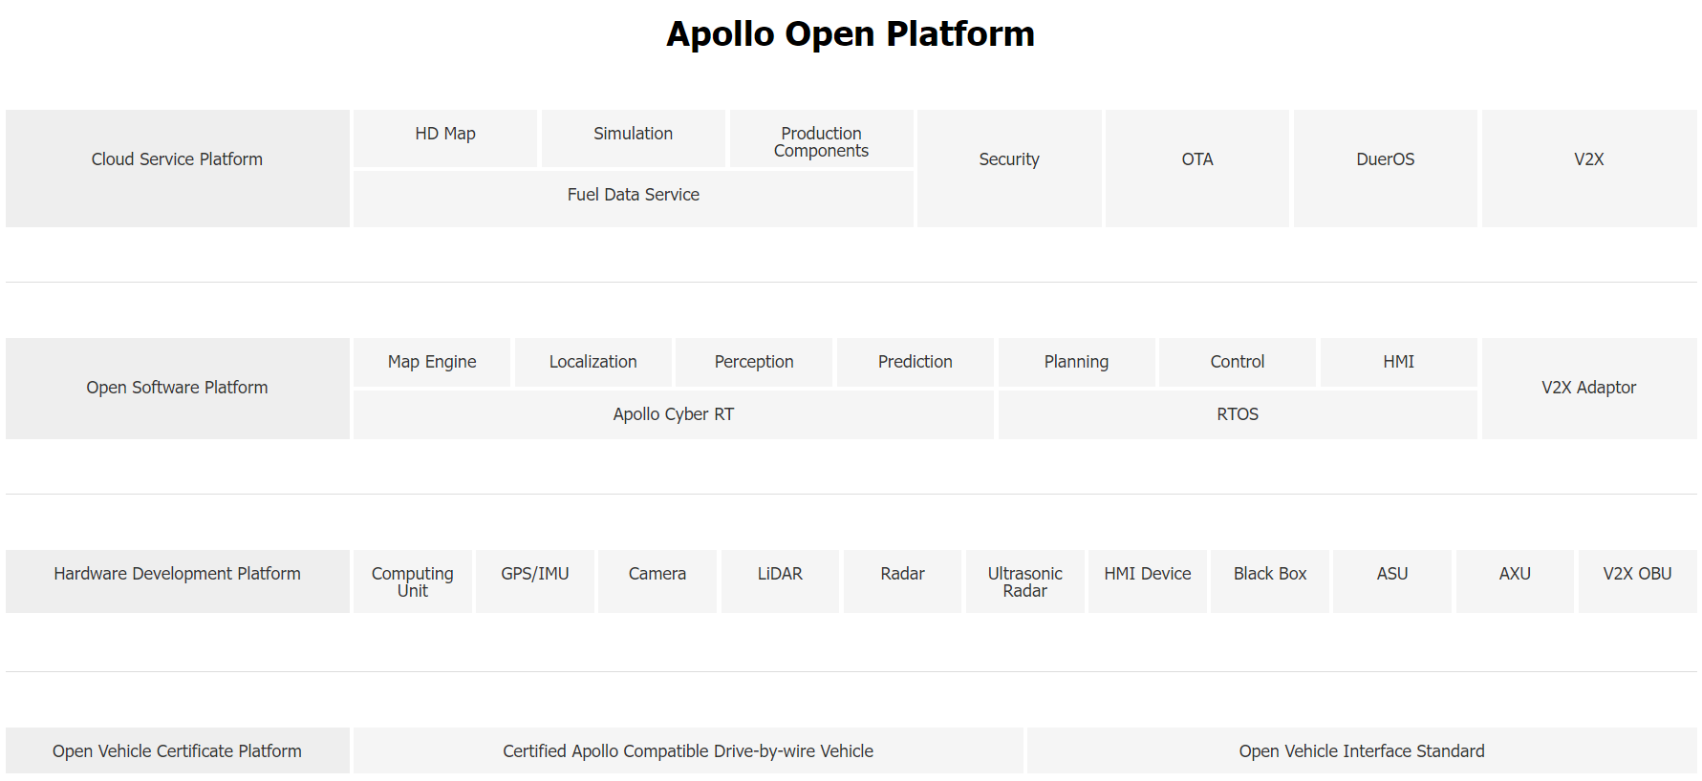
Baidu Apollo Stack
AD HW/SW stack
ROS → Cyber RT
Open source
ROS
Cyber RT
Source: Apollo.auto

Slide 19
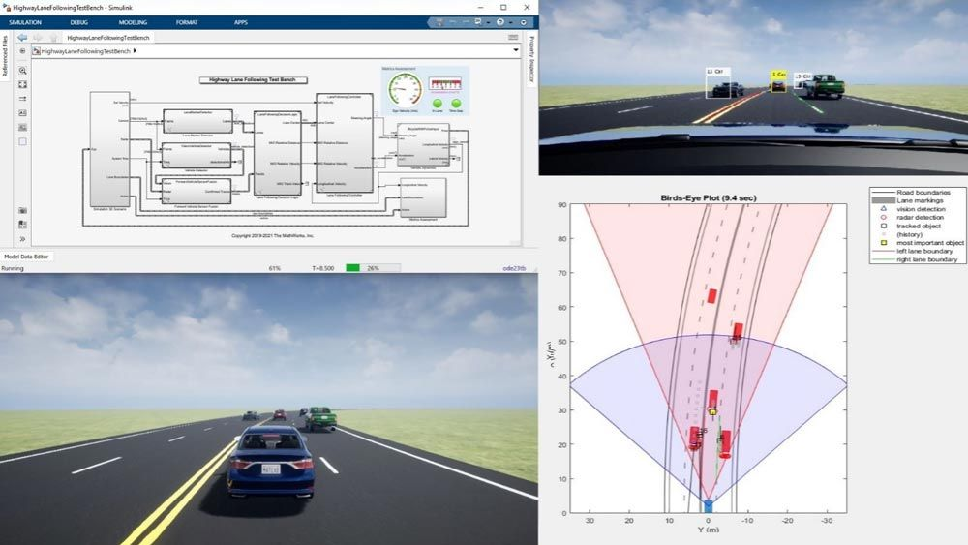
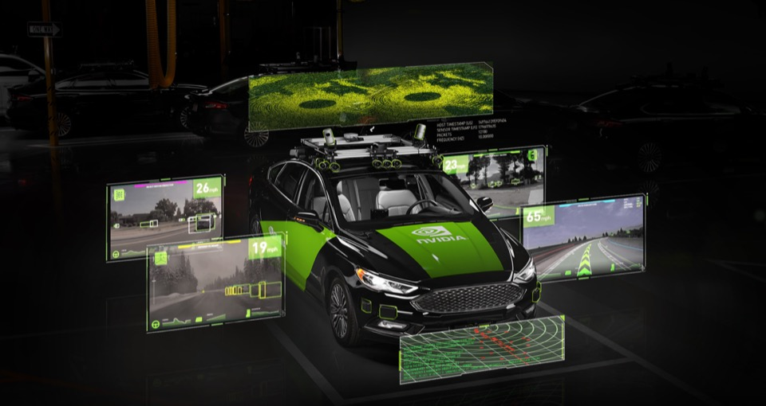
Other Frameworks
MATLAB/Simulink
Automated Driving Toolbox
Driving Scenario Designer & RoadRunner
NVIDIA DRIVE SDK
DRIVE OS: In-vehicle OS /w acc. comp.
DriveWorks: Middleware
DRIVE AV: Perception, mapping, planning stacks
DRIVE Chauffer: Highway & urban ADAS/AD
DRIVE IX: Cockpit sensing and AI
DRIVE Concierge: Digital assistant
DRIVE Map: Scalable fleet-sourced mapping
Source: Mathworks.com
Source: NVIDIA.com

Slide 20
References
M. Quigley, K. Conley, B. Gerkey, J. Faust, T. Foote, J. Leibs, R. Wheeler, and A. Ng, “ROS: an open-source Robot Operating System,” in ICRA 2009 Workshop on Open Source Software, vol. 3, Jan 2009. [Online]. Available: http://robotics.stanford.edu/~ang/papers/icraoss09-ROS.pdf
S. Macenski, T. Foote, B. Gerkey, C. Lalancette, and W. Woodall, “Robot operating system 2: Design, architecture, and uses in the wild,” Science Robotics, vol. 7, no. 66, p. eabm6074, 2022. [Online]. Available: https://www.science.org/doi/abs/10.1126/scirobotics.abm6074
R. R. Shamshiri, I. A. Hameed, and M. K. a. Weltzien, "Robotic Harvesting of Fruiting Vegetables: A Simulation Approach in V-REP, ROS and MATLAB", in Automation in Agriculture - Securing Food Supplies for Future Generations. London, United Kingdom: IntechOpen, 2018 [Online]. Available: https://www.intechopen.com/chapters/59402 doi: 10.5772/intechopen.73861
T. Samak, C. Samak, S. Kandhasamy, V. Krovi, and M. Xie, “AutoDRIVE: A Comprehensive, Flexible and Integrated Digital Twin Ecosystem for Autonomous Driving Research & Education,” Robotics, vol. 12, no. 3, p. 77, May 2023, doi: https://doi.org/10.3390/robotics12030077

